Slide 1


SDP-1 REVIEW-1 PROJECT MANAGEMENT SYSTEM
TEAM MEMBERS:
M. Jahnavi Lakshmi
M .Bhavana
D.Harika
from batch no. 377

Slide 2
ABSTRACT
Project management system is a process of managing a project in systematical order. To get a better outcome of the project we need take care of each and every step so that we can understand the project in a better way. As we are in pandemic situation where everything goes through online, so we want to create a website design which will help many industries in planning their projects, scheduling the work and allocating resources through online. This helps them in every process of their project. They can easily complete the assigned project virtually.

Slide 3
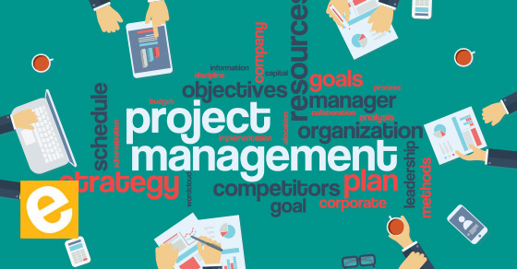
INTRODUCTION
Project management system means managing a project. it divides the project into different parts so that it will be easier to monitor the project. It has 5 phases which are know as initiating, planning, executing, monitoring and control, closing. These are the main phase in project management which help the user in understanding and implementing the project.
Initiating : It is the beginning of project. In this phase project members concentrate on the customer view point. This phase is about understanding and getting information about the project from the customer. By conducting research and surveys all the members of the project understanding what the project is about
.

Slide 4
Planning phase: It acts as the head of the project which helps the project members on how to undertake the project. After understanding the problem thoroughly, the requirements that are need for the project are specified in this step. In this phase the project members gets to know about the condition of the project, design limitations, functional and operational requirements.
Executing: it can be also called as implementing phase. In this phase all the planned things will be put into work. It acts as crucial phase as it includes executing of the project every team member will work on the assigned activity uses all the resources. Scheduling, time and task management plays a crucial role in this phase.

Slide 5
Monitoring and Control:
This phase monitors the execution part with planned part to ensure whether the project is in a position to proceed or not. It sees whether all the tasks that are agreed to guarantee are done or not and checks the time and budget of the project are stratified to ensure that the project can be proceed without any problem.
Closing: it is the last step of the project where a report is generated to the client or sponsor on the overall view and completion of the project. it also includes delivering the project to the customer, releasing contract, staff and equipment, and informing all the stakeholders on closure of the project.

Slide 6
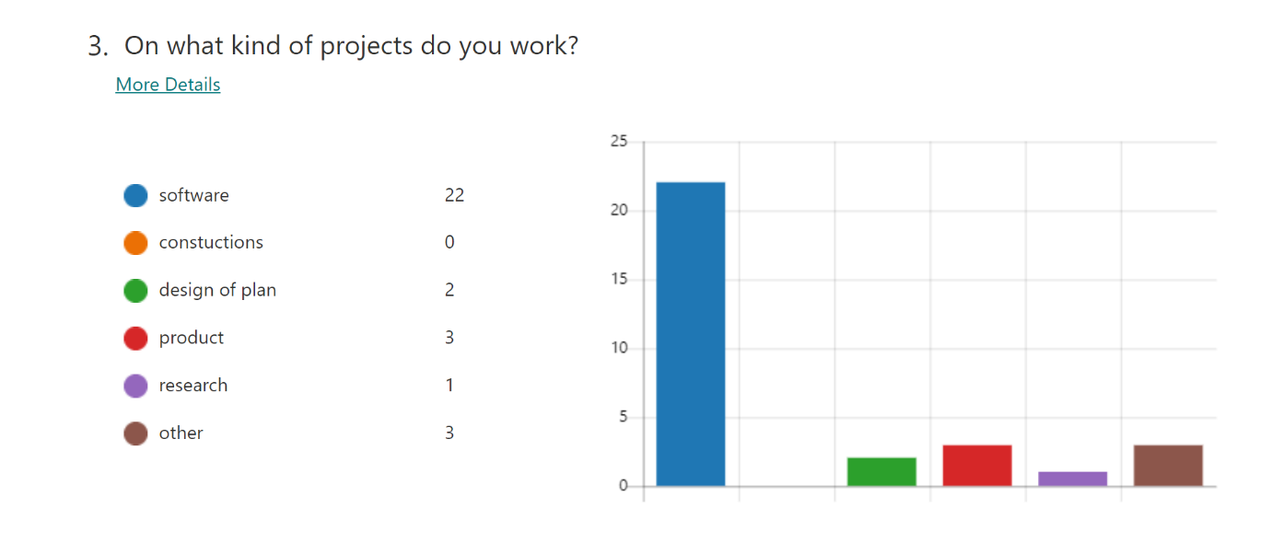
Survey on Project Management
We have conducted a survey on project management to know more about the people experience in management. We have researched on different project management system in different industries. So that we can create our SPD project which will help different kinds of projects.

Slide 7
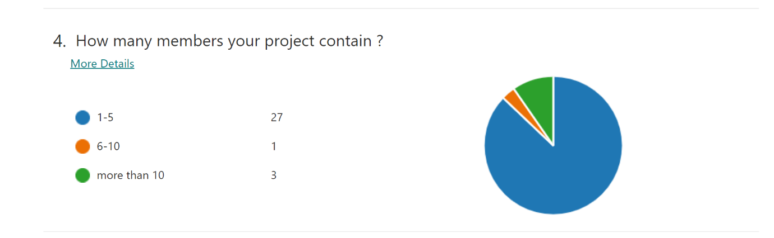
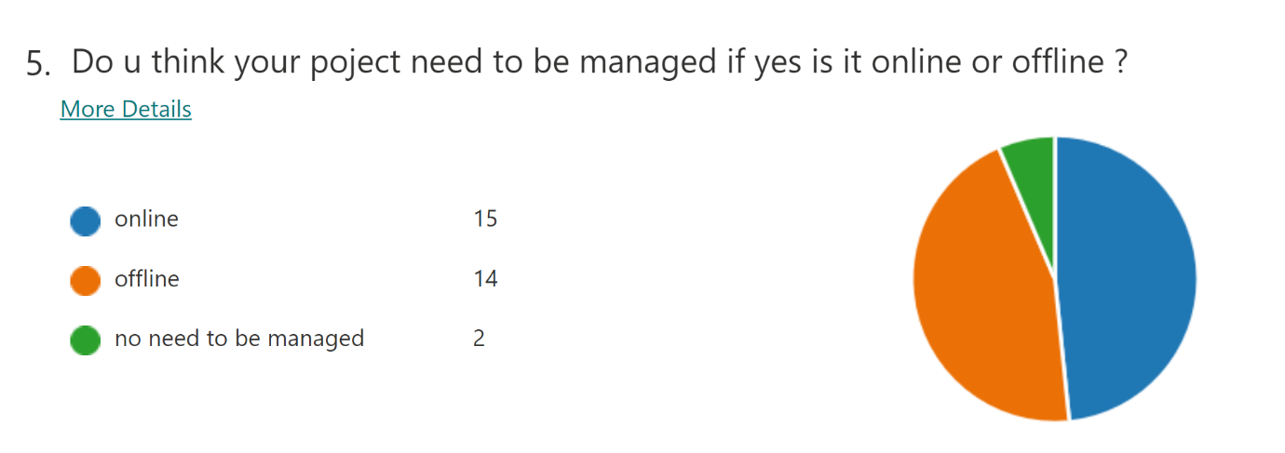

Slide 8
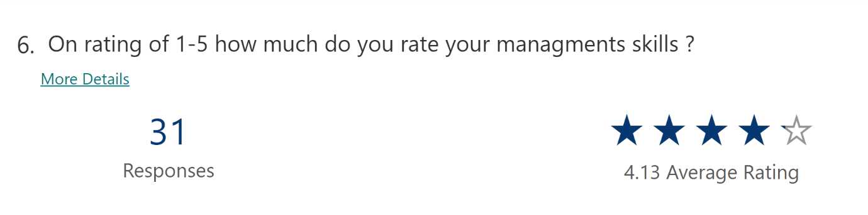
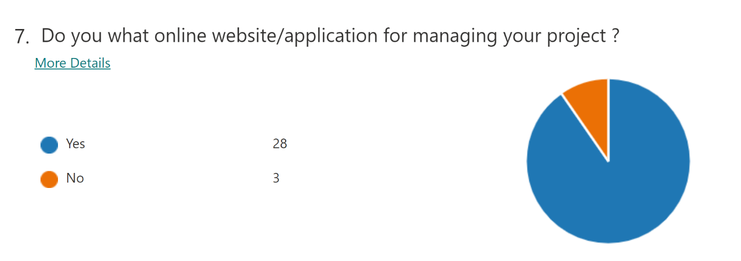

Slide 9
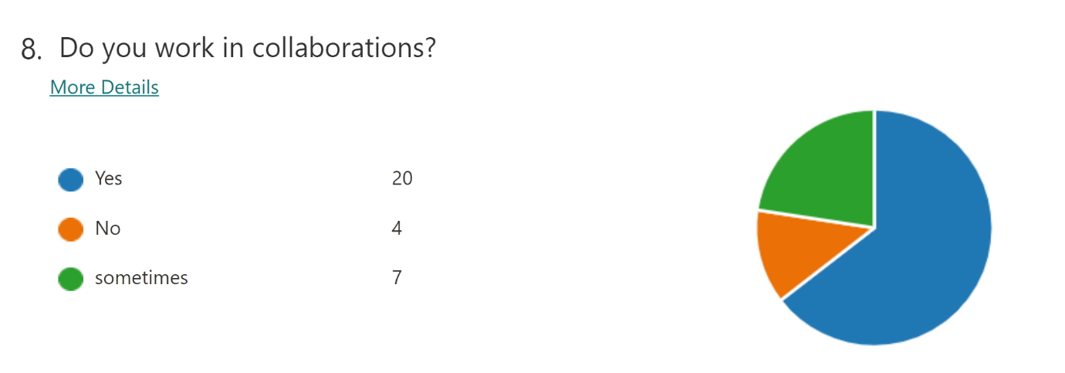

Slide 10
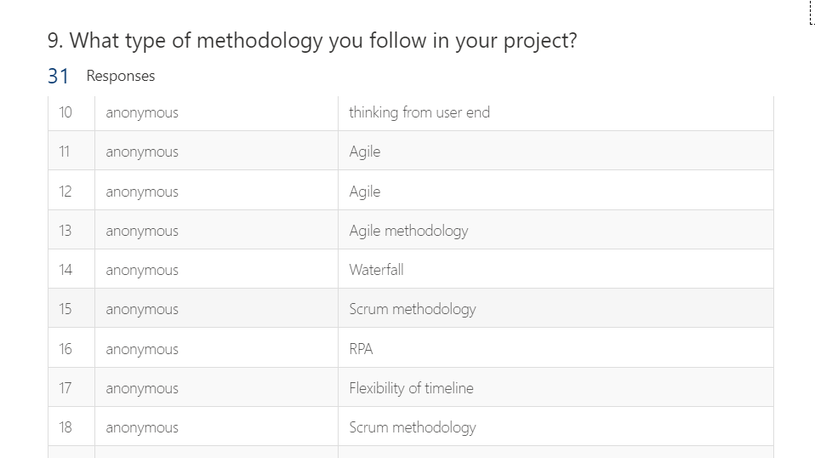

Slide 11
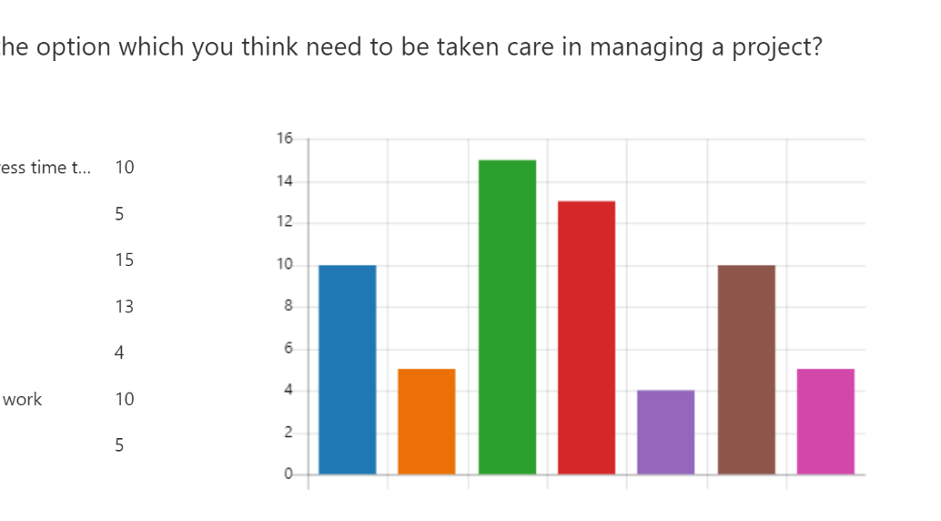

Slide 12
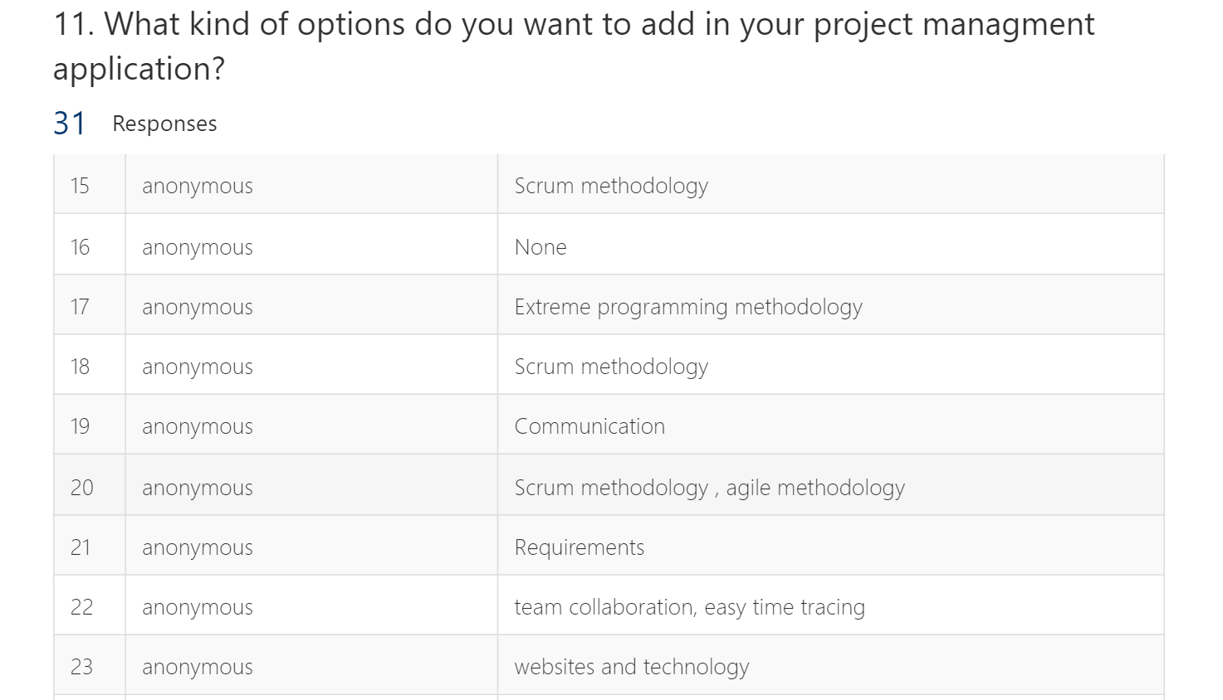

Slide 13
Reference Links:
https://study.com/
https://www.scoro.com/blog/best-project-management-software-list/
https://www.proofhub.com/articles/project-management-system
https://forms.office.com/r/MMR1EM4n7W
these are our reference and survey links that helped us in knowing more about project management.

Slide 14
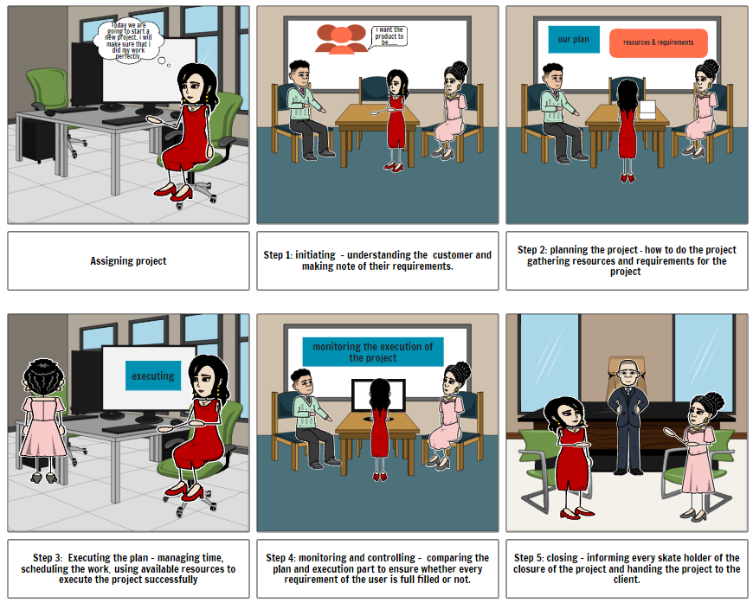
Customer Journey Map
We use this template to show our customer journey map. By doing this board we can see the overview of how project members will manage the project pictorically.

Slide 15
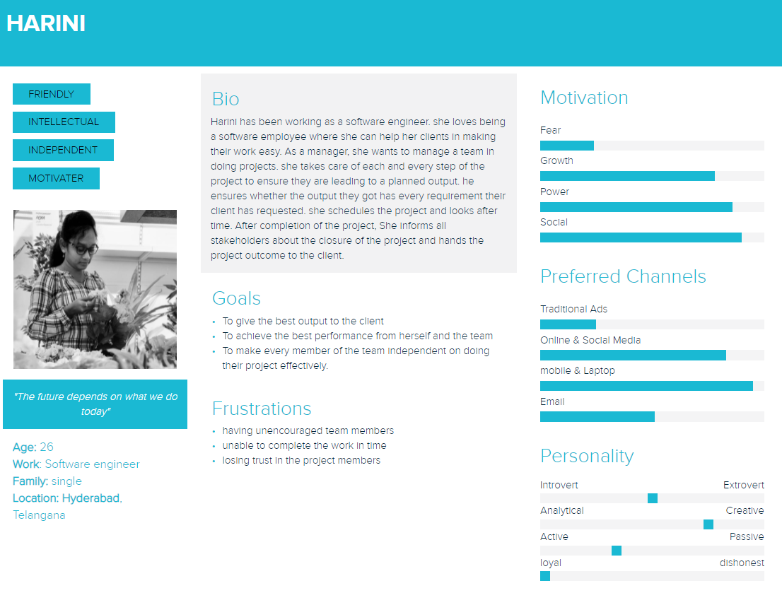

Slide 16
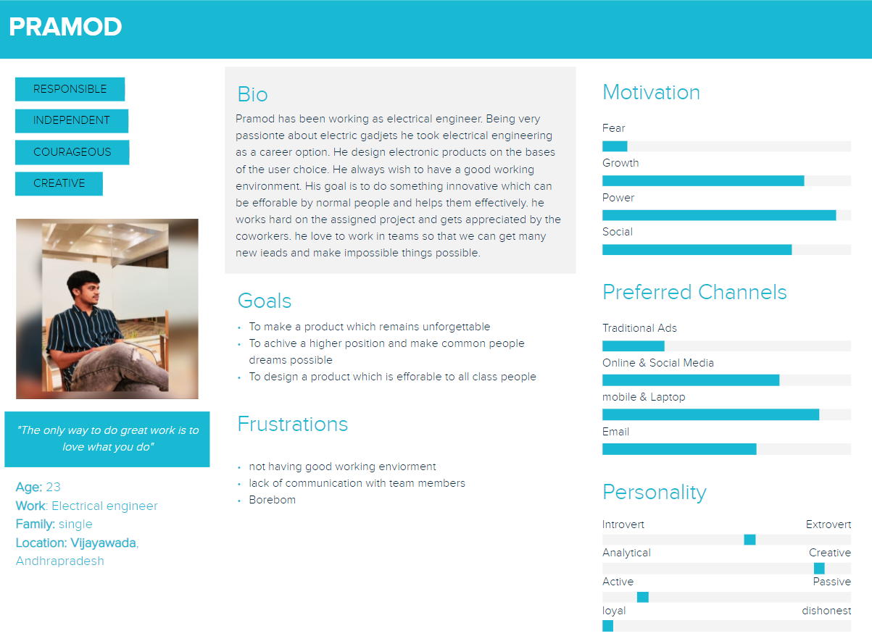

Slide 17
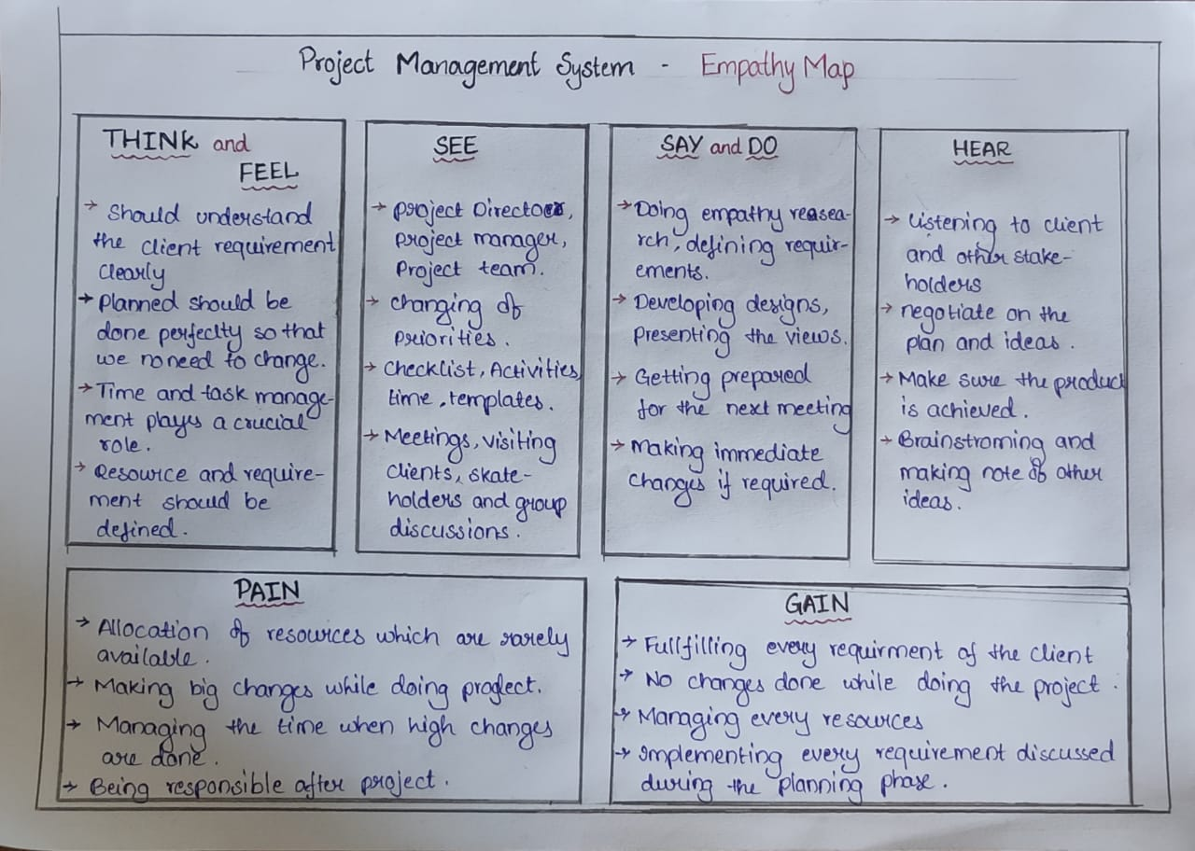
Empathy Map
By creating an empathy map we came to know about what the user sees, thinks, and listens in his working environment. we also know about that the work the user does and talks about his work. we made a note of pains and gains of the past works which can be taken care of in future.

Slide 18
Features:
1. This website will help the different kinds of industries in managing their project.
2. It make all kinds of management methodology available.
3. It allocate different kinds of option which helps user in every stage of doing project.
4. Different options for time management, allocating resources, scheduling, task management, cost and budget management, quality management.
5. it allows members in the group communicate and makes group discussions easy through online.

Slide 19
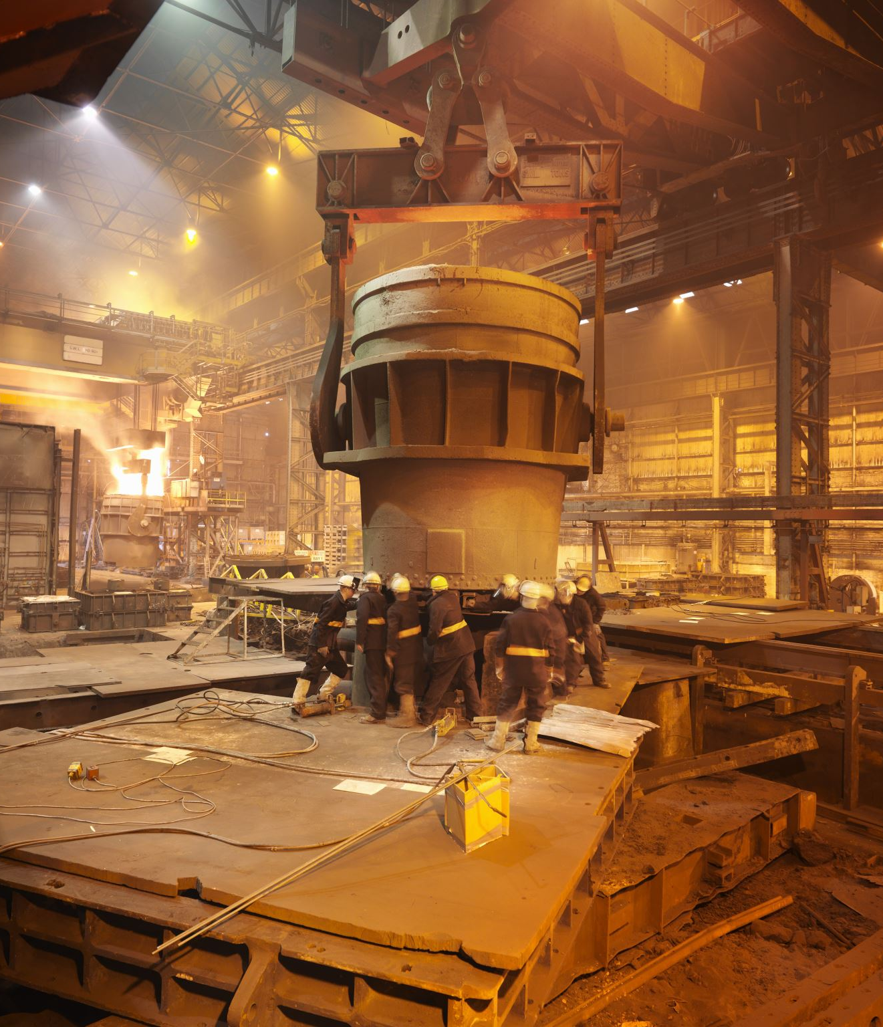
Linkedin link
https://www.linkedin.com/posts/jahnavi-lakshmi-40b4a9212_projectmanagement-project-kluniversity-activity-6851794601242632192-bq2j

Slide 20
CONCLUSION:
By going through all the research and empathy process we came to know how industries manage their projects. With all the gather information we understood how managing places a crucial role in giving effective result. So now we will implement our plan which will benefit all types of industries in managing their projects.

